Slide 1





Advanced Stress Packages
By the MODFLOW Development Team
MODFLOW 6 and FloPy: Take Your Modeling to the Next Level
Princeton, New Jersey, USA
Friday, May 31 – June 1, 2024

Slide 2
Advanced Stress Packages
More advanced stresses
Lake (LAK)
Streamflow Routing (SFR)
Multi-Aquifer Well (MAW)
Unsaturated Zone Flow (UZF)
Mover (MVR)
Typically involve solving some form of a water budget equation
As part of the formulation step (LAK, SFR, UZF, MVR)
Added as rows in the system of equations solved (MAW)

Slide 3
Advanced Stress Packages
State variables (e.g. head, stage, water content) are available for all advanced stress packages (except MVR Package)
ASCII – print_head, print_stage
Binary – save_head, save_stage, water_content (hds format)
Budgets are available for all advanced stress packages
Incremental and Cumulative budgets in the listing file
ASCII – print_flows
Binary – save_flows (cell-by-cell format)
Observations
State variables
Flow variables

Slide 4
Lake (LAK) Package

Slide 5
LAK Package Capabilities
Capabilities
multiple outlets per lake using 3 outlet equation options (specified, Manning, weir)
lakes on top of model (overlying), incised lakes, embedded lakes (sub-grid scale lakes)
constant stage and inactive lakes
explicitly defined lake connectivity
currently no UZF under lakes

Slide 6
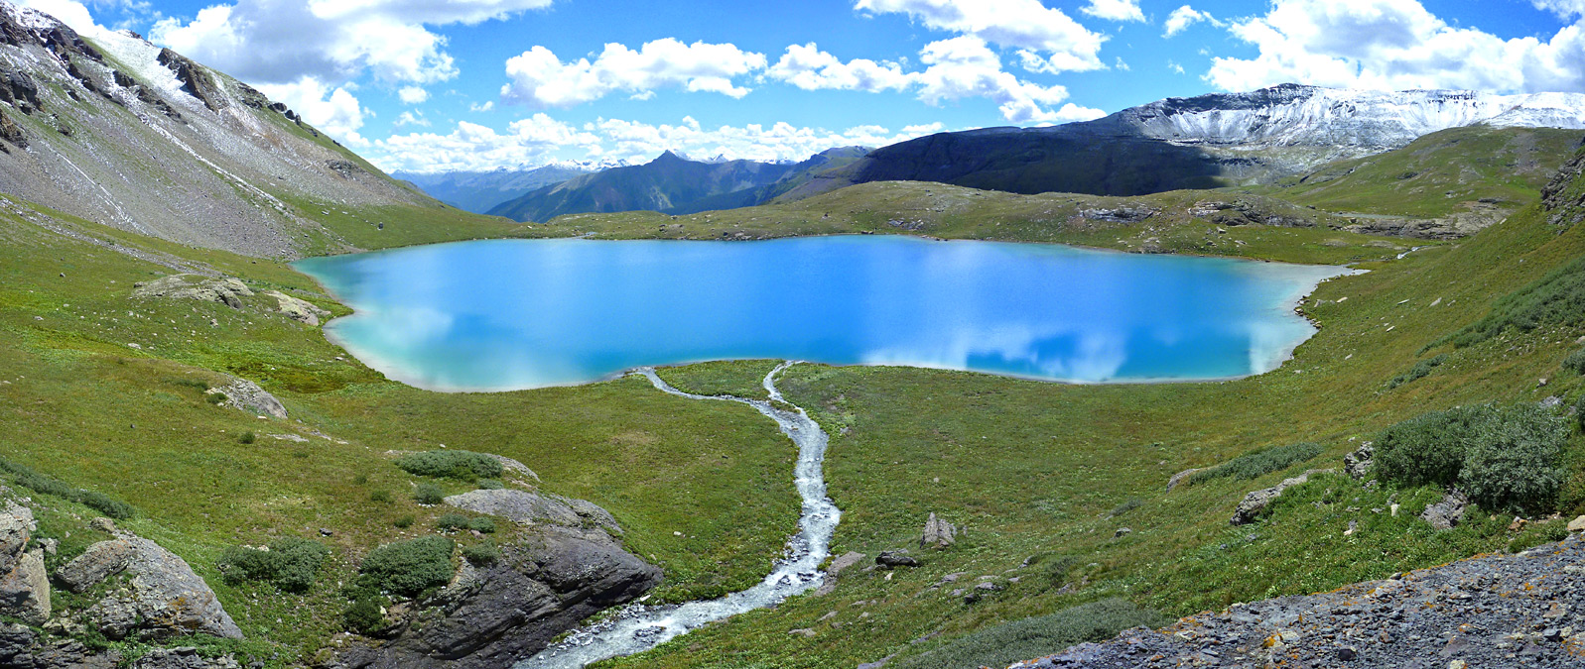
LAK Package Continuity Equation

Slide 7
StreamFlow Routing (SFR) Package

Slide 8
SFR Package Capabilities
Capabilities
multiple diversions from a single reach
downstream outflow from a reach to multiple segments using user-specified time-varying discharge fractions.
diversion priority scheme can be implemented based on diversion order
Inactive reaches
rectangular reaches
stream data are specified by reach
explicitly defined reach connectivity
currently no UZF under reaches
no Kinematic Routing (no reach storage changes)

Slide 9
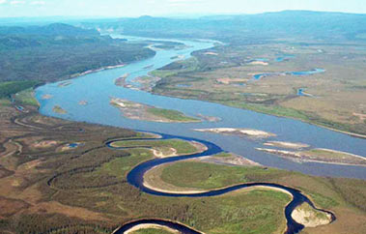
SFR Package Continuity Equation

Slide 10
SFR Package Connectivity

Slide 11
Multi-Aquifer Well (MAW) Package

Slide 12
MAW Package Capabilities
Capabilities
Solved as part of the matrix solution
Simplified data input
Flexible connectivity
Several well conductance formulations
Constraints (flow reduction and well shutdown)
Flowing well option
Can account for interbore storage changes
Constant and inactive wells
Differences
No support for
horizontal wells
partial penetration
non-linear head losses

Slide 13
Unsaturated Zone Flow (UZF) Package

Slide 14
UZF Package Continuity Equation
Kinematic-wave Equation for vertical unsaturated flow provides a solution for gravity flow with internal drainage.
Water Content
Internal drainage
Wetting
Front
Water
Table

Slide 15
UZF Package Variables
Brooks-Corey Equation
Required input variables

Slide 16
UZF Package Capabilities
Intended for basin scale studies
Simulates
Gravity flow in the unsaturated zone
Evapotranspiration (unsaturated and saturated)
Infiltration excess (rejected infiltration)
Saturation excess (groundwater discharge to land surface)

Slide 17
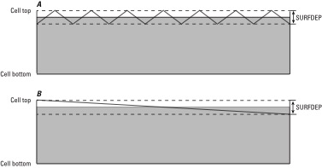
UZF Package Infiltration

Slide 18
UZF Package Groundwater Seepage
Groundwater Seepage – Water Table is Close to Land Surface

Slide 19
Mover (MVR) Package

Slide 20
MVR Package
CONSTRAINTS
PROVIDER
RECEIVER
Package
Discharge
One to One
Provider 1
Receiver 1
One to Many
Receiver 2
Provider 2
Receiver 3
Many to One
Provider 3
Receiver 4
Provider 4

Slide 21
MVR Package Providers and Receivers
Provider
Drain package
General-head boundary package
River package
Well package
Provider and Receiver
Lake package
Multi-aquifer well package
Streamflow routing package
Unsaturated zone package
Available water for mover is reduced by multiple receivers with the same provider in order listed in Mover package

Slide 22
MVR Package Constraints
Fraction
Discharge x fraction is sent to the receiver
Excess
Any water that exceeds the user-specified rate is provided to the receiver. No water is provided to the receiver if the available water is less than the user-specified value. (Flood control)

Slide 23
MVR Package Constraints
Threshold
No flow is provided to the receiver until the available water exceeds the user-specified rate. Once the available water exceeds the user-specified rate, then the user-specified rate is provided to the receiver. (Priority)
Up To
All of the available water will be taken from the provider up to the user-specified rate. Once user-specified rate is exceeded, the receiver will continue to get the user-specified rate.

